Slide 1
SIGNATURE VERIFICATION USING MATLAB IMAGE PROCESSING
BANAVATH SIDDHU - 18101007
MALLA SATISH KUMAR - 18101022
PILLA NIVEEN KUMAR - 18101029

Slide 2
Motivation
Even in todays age signature is the most important and most used form of proof of identity of a person. Signatures are used for all documents in financial services, legal services or on letters, documents, checks, security documents.
Thus to reducing illegal acts like forgery are a great concern in our day and age.
Negligence of signature verification is one of the main cause of fraud in our country.
This was the motivation for our project.

Slide 3
Problem Statement
To write a program in MATLAB that can distinguish between genuine and forged signatures with high accuracy.

Slide 4
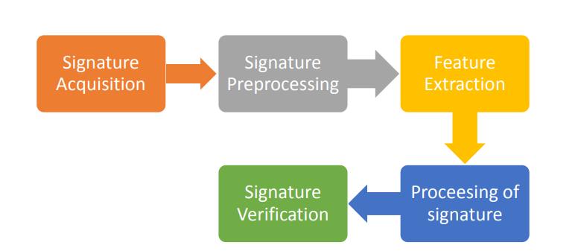
PROJECTED METHODOLOGY

Slide 5
Methodolgy
Database Preparation
Pre-Processing
Feature Extraction
Verification using extracted Features

Slide 6
Database Preparation
For the database preparation, we require a square image with high resolution and which is noise free.
Signature should be made on an uncrumbled blank sheet of paper and shot with a camera which is focused on the image.
The image should then be modified to a square resolution to be used.
Because of privacy issues, not many people agree to make their signatures available to others and that too for practicing forgeries. Therefore, it is still not easy to develop a sufficiently large database with quality signatures.
Thus we have requested and taken signatures of our friends to make the database. All taken signatures were labelled genuine.
Then we made forgeries for every genuine signature and we labelled them as forgeries. We have populated our database in such a manner.

Slide 7
Pre-Processing
The Steps of Pre-Processing of the image from database is :
1. Cropping
2. Filtering
3. Conversion of Colour Image to Gray scale
4. Binarization of Grey scale image
5.Thinning
6. Rotation for Skew Correction
7. Resizing

Slide 8
Feature Extraction
The following features are to be extracted from the processed images:
Normalised Signature Area
Total number of black signature pixels divided by total number of pixels of the image
Aspect Ratio
The Aspect ratio of the processed image = width/height
Maximum Horizontal Projection
It is the maximum number of black pixels among all horizontal rows of the image

Slide 9
Feature Extraction
The following features are to be extracted from the processed image: (continued)
End Points
It is the number of endpoints of the signature
Centroid of vertically divided images
It is the pair of centroid of the 2 images formed by vertically dividing the main image
Skew Angle
It is the angle made by the centroids of the vertically divided images

Slide 10
Verification using Extracted Features
Once the Features are extracted they are stored in a Vector. Now we need to fix minimum error threshold values for each feature implemented using which it classifies genuine signatures.
Conventionally finding the error threshold values should be done by using an Machine Learning Algorithm that will minimize the error threshold.
But since we have not been taught Machine Learning, we have done this step manually by generating the tables of data for input and selecting error threshold values. The more images this step is applied to the more accurate our algorithm becomes.

Slide 11
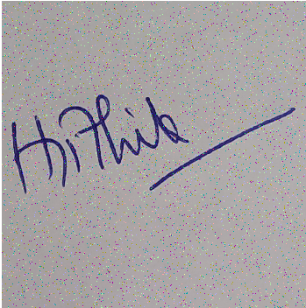
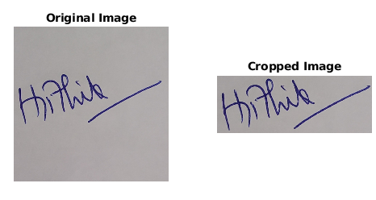
PROGRESS FOR PRE-PROCESSING
CROPPING IMAGE :- 2) FILTERING IMAGE:-

Slide 12
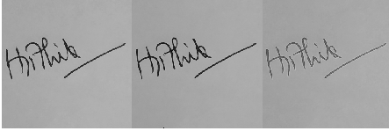
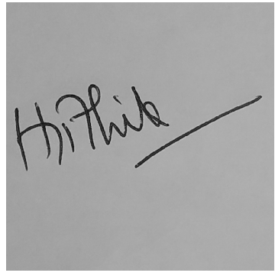
2) FILTER IMAGE-2
3) CONVERSION OF COLOUR IMAGE TO GRAY SCALE

Slide 13
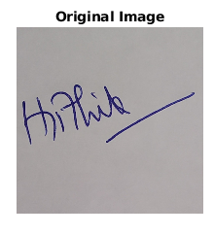
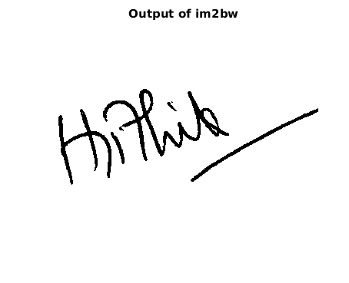
4) BINARIZATION OF GREY SCALE IMAGE

Slide 14
IMPLEMENTATION
END SEM

Slide 15
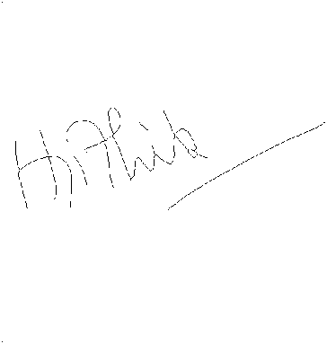
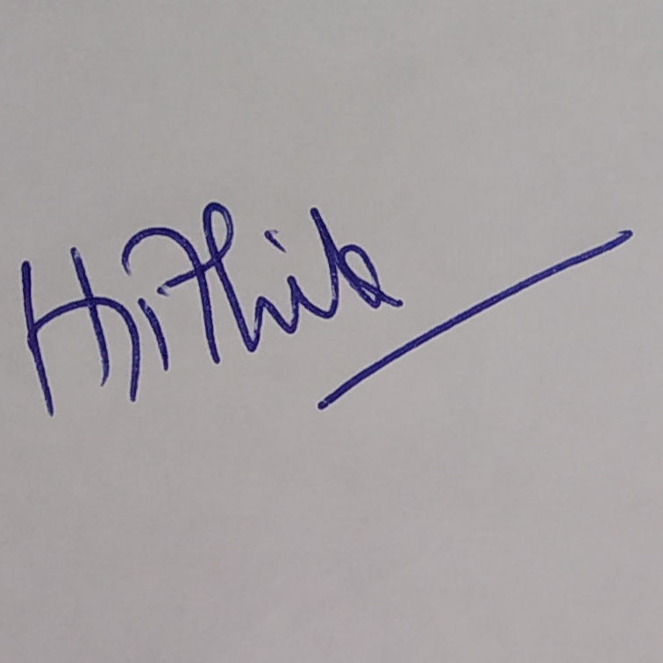
5) Thinning Image :-

Slide 16
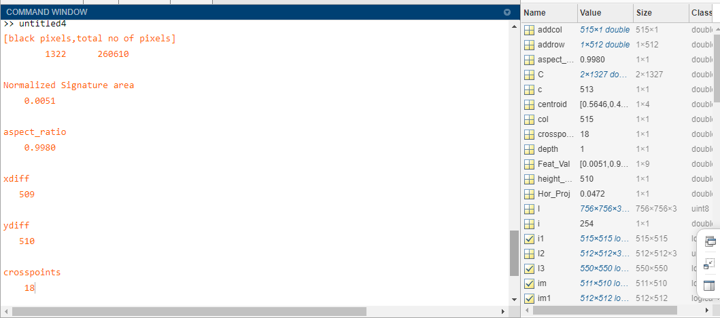
Feature Extraction

Slide 17
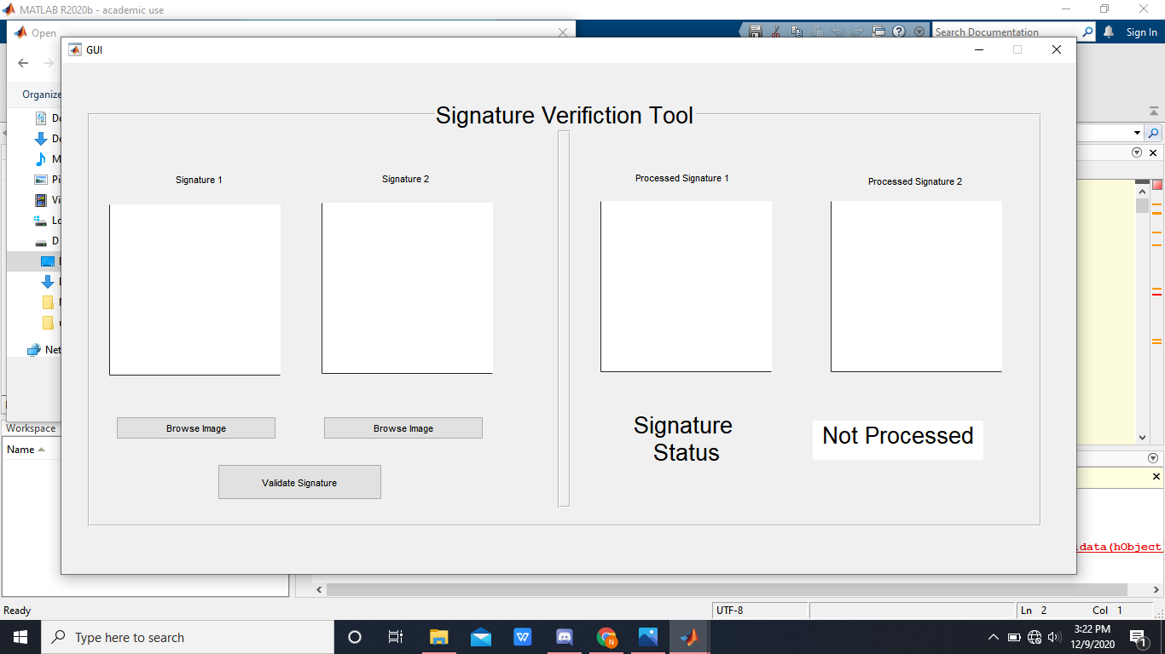
GRAPHICAL USER INTERFACE(GUI)

Slide 18
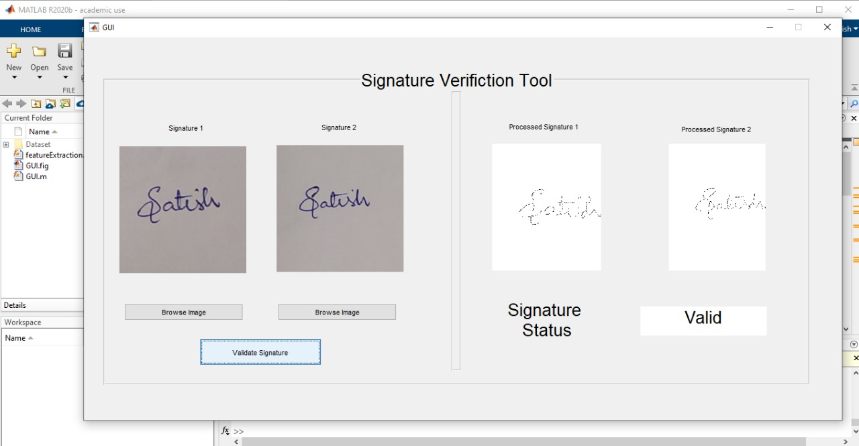
GRAPHICAL USER INTERFACE(GUI)

Slide 19
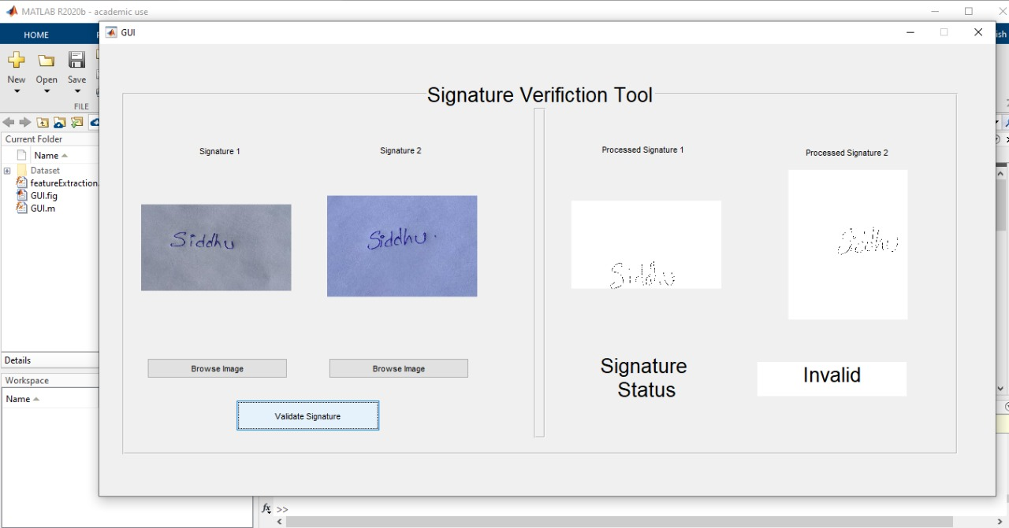
GRAPHICAL USER INTERFACE(GUI)

Slide 20
CONCLUSION
For training and testing we have done many feature exraction of signatures in matlab.
When we insert the signatures into GUI model it varifies the given data is valid or invalid . so, by this we can verify every signature using GUI model.

Slide 21
References
Research Paper Followed : http://shodhganga.inflibnet.ac.in/bitstream/10603/176862/8/08_chapter%202.pdf
Harpreet Anand,Prof. D.L Bhombe, “ENHANCED SIGNATURE VERIFICATION AND RECOGNITION USING MATLAB,” IJIRAE, vol. 1, no. 4, p. 7, 2014.
H. Kabir, “Offline Signature Verification using Local key point Features”, International Journal of Computer Applications, Vol. 1, No.27, pp. 61-70, 2010.
R. Plamondon and S.N. Srihari, "Online and Offline Handwriting Recognition: A Comprehensive Survey", IEEE Tran. on Pattern Analysis and Machine Intelligence, vol.22 no.1, pp.63-84, Jan.2000

Slide 22
THANK YOU

